Slide 1
Relays

Slide 2
Key pads use a 4x4 matrix
1 number on the keypad is controlled by shorting two wires in the matrix

Slide 3
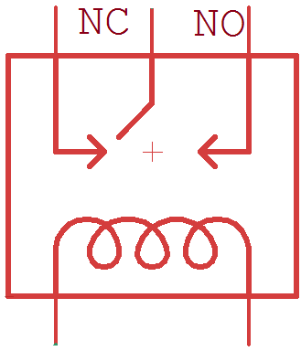
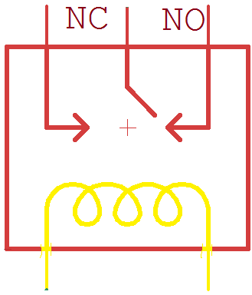

Slide 4
By using 11 relays* we can control each button, and use the Arduino to talk to the safe and crack the combination.
*Enter and Key have the same function

Slide 6
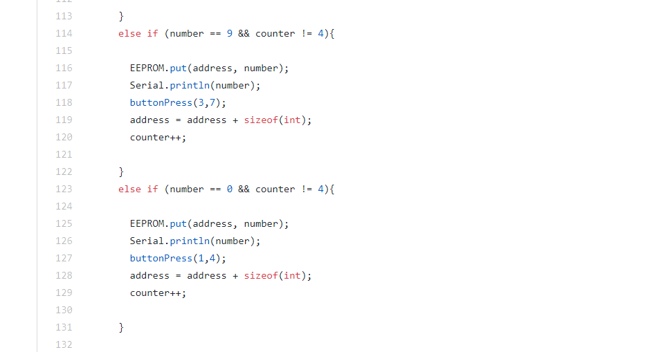
Writing to EEPROM

Slide 7
Win Conditions
-Photocell checking length of light being on
-Light on longer than 3 seconds, activate servo

